Slide 1
Section 1.3 Transformations with Reflections

Slide 2
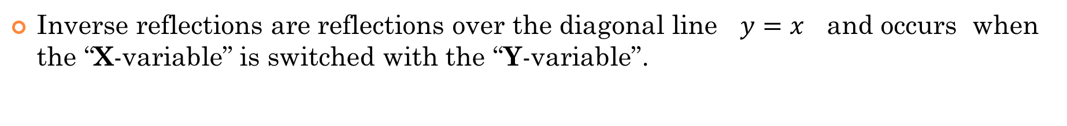
Reflections:
There are 3 types of reflections that we will discuss in this section:
Horizontal reflections are reflections over the Y-axis and occur when the x-variable is replaced with “negative x”.
Vertical reflections are reflections over the X-axis and occurs when the y-variable is replaced with “negative y”.
Inverse reflections are reflections over the diagonal line $y=x$ and occurs when the “X-variable” is switched with the “Y-variable”.

Slide 3
I) Reflections over the Axis
A reflection occurs when we flip an object over an axis (mirror line)
No rotations/translations/change in size
Vertical Reflection
Horizontal Reflection
Inverse Reflection
Reflected over the X-axis
Reflected over the Y-axis
Reflected over the line y = x
y
y
y
5
5
5
4
4
4
3
3
3
2
2
2
1
1
x
1
x
x
-5
-4
-3
-2
-1
0
1
2
3
4
5
-5
-4
-3
-2
-1
0
1
2
3
4
5
-5
-4
-3
-2
-1
0
1
2
3
4
5
-1
-1
-1
-2
-2
-2
-3
-3
-3
-4
-4
-4
-5
-5
-5
© Copyright All Rights Reserved Homework Depot www.BCMath.ca

Slide 4
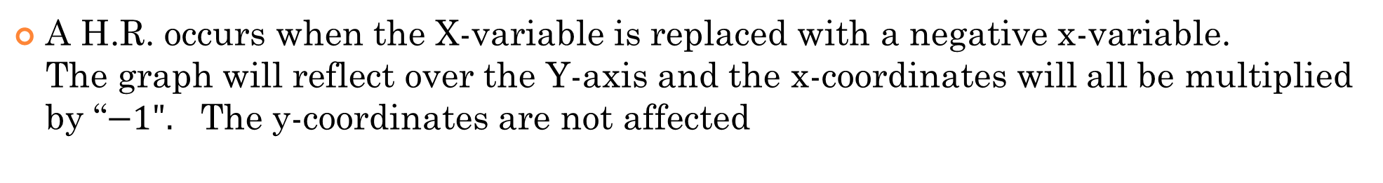
Horizontal Reflections:
A H.R. occurs when the X-variable is replaced with a negative x-variable. The graph will reflect over the Y-axis and the x-coordinates will all be multiplied by “$−1".$ The y-coordinates are not affected
Algebraically, a negative sign will be placed in front of each x-variable
y
y
8
8
6
6
4
4
2
2
x
x
-8
-6
-4
-2
0
2
4
6
8
-8
-6
-4
-2
0
2
4
6
8
-2
-2
-4
-4
-6
-6
-8
-8
© Copyright All Rights Reserved Homework Depot www.BCMath.ca

Slide 5
Graphing Reflections:
When graphing a horizontal reflection: $x→−x$ , the graph is reflected over the “Y” axis, multiply all the “x” coordinates by $−1$. The y-coordinates will stay the same!
When graphing a vertical reflection: $y→−y$ , the graph is reflected over the “X” axis, multiply all the “y” coordinates by $−1$. The X-coordinates will stay the same!
HORIZONTAL REFLECTIONS
VERTICAL REFLECTIONS
y
y
5
5
4
4
3
3
2
2
1
x
1
x
-5
-4
-3
-2
-1
0
1
2
3
4
5
-5
-4
-3
-2
-1
0
1
2
3
4
5
-1
-1
-2
-2
-3
-3
-4
-4
-5
-5

Slide 6
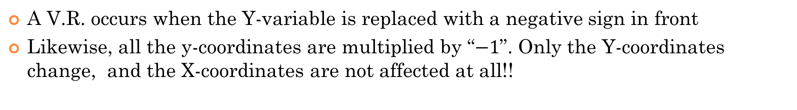
II) Vertical Reflections
A V.R. occurs when the Y-variable is replaced with a negative sign in front
Likewise, all the y-coordinates are multiplied by “$−1$”. Only the Y-coordinates change, and the X-coordinates are not affected at all!!
Y-Variable must be isolated!!
Algebraically, a negative sign will be placed in front of each y-variable
y
y
8
8
6
6
4
4
2
2
x
x
-8
-6
-4
-2
0
2
4
6
8
-8
-6
-4
-2
0
2
4
6
8
-2
-2
-4
-4
-6
-6
-8
-8
© Copyright All Rights Reserved Homework Depot www.BCMath.ca

Slide 7
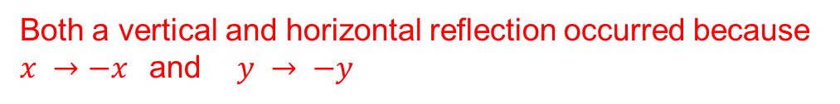

Difference Between H.R and V.R.
For H.R. the negative sign will be placed directly in front of the “x variable
For V.R. the negative sign will be placed directly in front of the “y variable”
This is a Horizontal Reflection because $X → −X$
This is a Vertical Reflection because $y→ −y$
Both a vertical and horizontal reflection occurred because $x →−x$and $y → −y$
This transformation can be interpreted in two different ways
Vertical Reflection
Horizontal Reflection
© Copyright All Rights Reserved Homework Depot www.BCMath.ca

Slide 8
Practice: Indicate whether if the following reflections are horizontal, vertical, both, or either

Slide 9
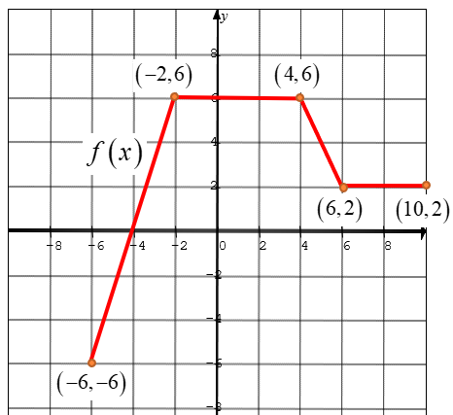
Ex: Given the graph of y = f(x), draw the graph of
y
8
6
4
2
x
-8
-6
-4
-2
0
2
4
6
8
-2
-4
-6
-8
© Copyright All Rights Reserved Homework Depot www.BCMath.ca

Slide 10
IV) Summary
Horizontal Reflection over the Y-axis
Vertical Reflection over the X-axis
The Y variable is always isolated, so the Negative sign is often moved to the other side
© Copyright All Rights Reserved Homework Depot www.BCMath.ca

Slide 11
Ex: Indicate the type of reflection for each transformation:
Vertical Reflection!
Vertical Reflection!
Horizontal Reflection!
Horizontal Reflection!
© Copyright All Rights Reserved Homework Depot www.BCMath.ca

Slide 12
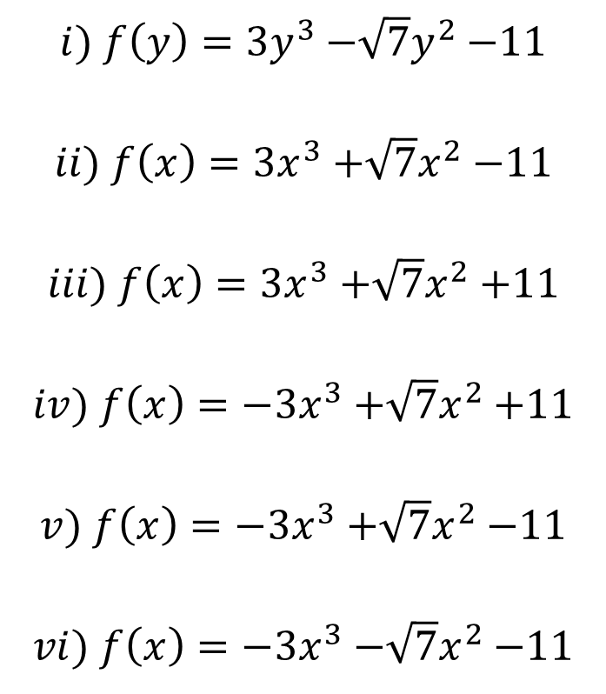
Ex: Given the equation $g\left(x\right)=3x^{3}{−\sqrt{7}x}^{2}−11$, what will the equation look like after each reflection?
i) Horizontal reflection
$$i) f\left(y\right)=3y^{3}{−\sqrt{7}y}^{2}−11$$ $$ii) f\left(x\right)=3x^{3}{+\sqrt{7}x}^{2}−11$$
$$iii) f\left(x\right)=3x^{3}{+\sqrt{7}x}^{2}+11$$
$$iv) f\left(x\right)=−3x^{3}{+\sqrt{7}x}^{2}+11$$
$$v) f\left(x\right)=−3x^{3}{+\sqrt{7}x}^{2}−11$$
$$vi) f\left(x\right)=−3x^{3}{−\sqrt{7}x}^{2}−11$$
ii) Vertical reflection
iii) Both Horizontal & Vertical reflection

Slide 13


Combined Transformations Reflections with Translations
When you have both translations and reflections, you can order these transformations in different orders to get the same results.
Graph of $y=f(x)$ is shifted 3 units left
Graph of $y=f(x)$ is horizontally reflected over the Y-axis
????
The first method is the factoring method, where you read the transformations from left to right
H.Shift 3 units right
Horizontal Reflection over the Y-axis
2nd method is the “Circle” method, circle the variable in each step of the transformations and indicate how the variables are directed affected
$$x→x+3$$ H.Shift 3 units left
$$x→−x$$ H.R over Y-axis

Slide 14
Graphical Explanation of Multiple Transformation
Suppose you are given the function $y=\sqrt{x+2}$, indicate how the graph looks after the following transformation
Method 1: Factoring Method
Method 2: Circling Method
y
Step 1: HR. over Y-axis
y
Step 1: HS 3 units left
4
4
2
2
Step 2: HR over the Y-axis
Step 2: HS. 3 units Right
x
x
-5
-4
-3
-2
-1
0
1
2
3
4
5
-5
-4
-3
-2
-1
0
1
2
3
4
5
BOTH transformations yield the same graph, that means they are the same and can be performed using either methods
-2
-2

Slide 15
When performing transformations with multiple steps, take the time to write out the transformation for each step
The factoring method and circling method may have transformation done in different orders but end up with the same overall result
Ex: Indicate the transformations in steps for each of the following. Perform your transformations in two different ways:

Slide 16
Practice: Indicate the transformations in order

Slide 17
Ex: Given that (a,b) is a point on y=f(x), find the coordinates of a point on the function:
V.R.
H.R.
Therefore, a new coordinate in the function will be:
V.R.
I.R.
I.R.
H.R.
Therefore, a new coordinate in the function will be:
© Copyright All Rights Reserved Homework Depot www.BCMath.ca

Slide 18
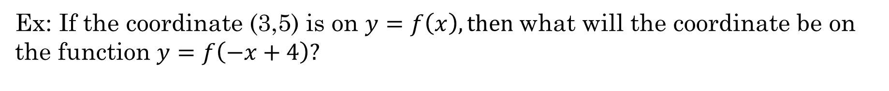
Ex: If the coordinate (3,5) is on $y=f\left(x\right), then$what will the coordinate be on the function $y=f\left(−x+4\right)?$
a) ($−3$,5) b) ($−7$,5) c) ($1$,5) d) ($3$,1) e) ($−3$,9)

Slide 19
Ex: Given that the coordinate (a,b) is on the function y=f(x), what will the coordinate become after each transformation?

Slide 20
Ex: Given that the coordinate (a,b) is on the function y=f(x), what will the coordinate become after the three transformations in the given order?
1. Translation of 3 units right
2. Horizontal Reflection
3. Translate 10 units left

